Slide 1

The Wumpus world
D.UTHRADEVI
(19PITE18)

Slide 2
SYNOPSIS:
Introduction of FOL
Wumpus world
First-Order Logic in Wumpus World
Difficulties with first-order logic
Primitive goal based ideas
Conclusion

Slide 3
Introduction of FOL
First-order logic is another way of knowledge representation in artificial intelligence. It is an extension to propositional logic.
FOL is sufficiently expressive to represent the natural language statements in a concise way.
First-order logic is also known as Predicate logic or First-order predicate logic. First-order logic is a powerful language that develops information about the objects in a more easy way and can also express the relationship between those objects.
First-order logic (like natural language) does not only assume that the world contains facts like propositional logic but also assumes the following things in the world:
Objects: A, B, people, numbers, colors, wars, theories, squares, pits, Wumpus.
Relations: It can be unary relation such as: red, round, is adjacent, or n-any relation such as: the sister of, brother of, has color, comes between
Function: Father of, best friend, third inning of, end of.
As a natural language, first-order logic also has two main parts:
Syntax
Semantics

Slide 4
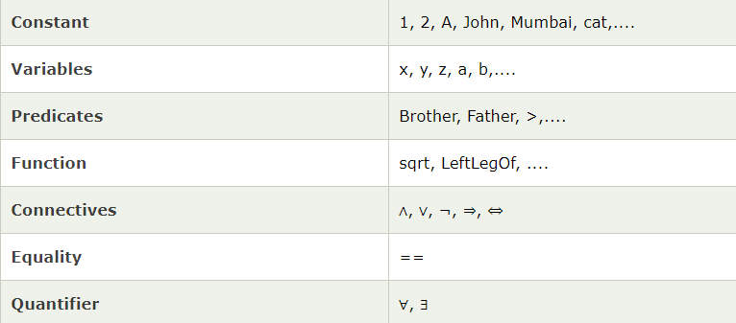
Basic Elements of First-order logic:

Slide 5
Quantifiers in First-order logic:
A quantifier is a language element which generates quantification, and quantification specifies the quantity of specimen in the universe of discourse.
These are the symbols that permit to determine or identify the range and scope of the variable in the logical expression. There are two types of quantifier:
Universal Quantifier, (for all, everyone, everything)
Existential quantifier, (for some, at least one).

Slide 6
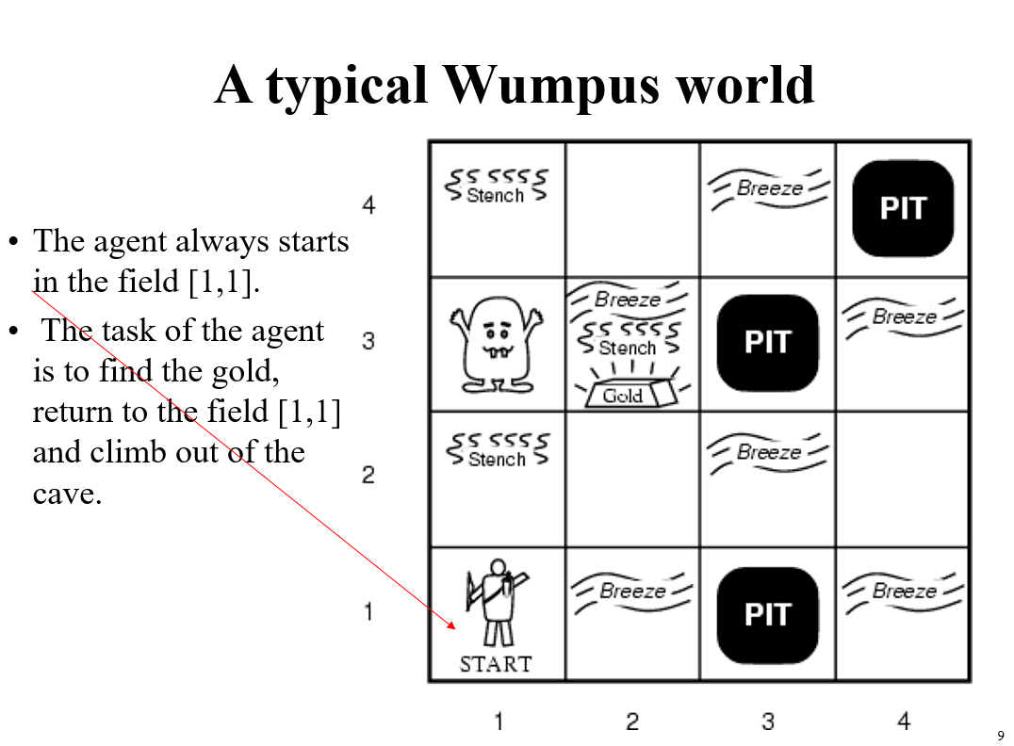
Wumpus world

Slide 7
First-Order Logic in Wumpus World
Actions:
Turn(Right), Turn(Left), Forward, Shoot, Grab, Climb .
Suppose an agent perceives a stench, breeze, no glitter at time t = 5:
Percept([Stench, Breeze, None],5)
[Stench, Breeze, None] is a list
Then want to query for an appropriate action. Find an a (ask the KB):

Slide 8
Contd..
Simplifying the percept and deciding actions:

Slide 9
Simple Reflex Agent
Agent Keeping Track of the World

Slide 10
Contd..
Properties of locations:
Infer cause from effect:
Infer effect from cause:

Slide 11
Contd..
Causal rule doesn’t say if squares far from pits can be breezy.
Keeping track of the world is important
Without keeping track of state...
Cannot head back home
Repeat same actions when end up back in same place
Unable to avoid infinite loops
Do you leave, or keep searching for gold?
Want to manage time as well
Holding(Gold, Now) as opposed to just Holding(Gold)

Slide 12
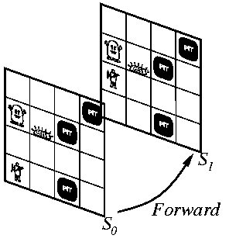
Situation Calculus
Adds time aspects to first-order logic Result function connects actions to results

Slide 13
Describing actions
Pick up the gold!
Stated with an effect axiom
When you pick up the gold, still have the arrow!
Nonchanged: Stated with a frame axiom

Slide 14
Contd..
For each predicate (not action):
P is true afterwards means
An action made P true, OR
P true already and no action made P false
Holding the gold:

Slide 15
Difficulties with first-order logic
Frame problem
Need for an elegant way to handle non-change
Solved by successor-state axioms
Qualification problem
Under what circumstances is a given action guaranteed to work? e.g. slippery gold
Ramification problem
What are secondary consequences of your actions? e.g. also pick up dust on gold, wear and tear on gloves, etc.
Would be better to infer these consequences, this is hard

Slide 16
Keeping track of location
Direction (0, 90, 180, 270)
Define function for how orientation affects x,y location

Slide 17
Contd..
Define location ahead:
Define what actions do (assuming you know where wall is):

Slide 18
Primitive goal based ideas
Once you have the gold, your goal is to get back home

Slide 19
Conclusion:
How to work out actions to achieve the goal?
Inference: Lots more axioms. Explodes.
Search: Best-first (or other) search. Need to convert KB to operators
Planning: Special purpose reasoning systems.

Slide 20
References:
https://www.youtube.com/watch?v=cTUX_Q4MMHw
https://slideplayer.com/slide/272698/
https://www.techfak.uni-bielefeld.de/ags/wbski/lehre/digiSA/WS0506/MDKI/Vorlesung/vl08_FOL.pdf
https://www.youtube.com/watch?v=fnwjsO9ky9o
https://www.youtube.com/watch?v=Bz_cFuf4aQg

Slide 21
Thank you
Bye

